Slide 1
Get your prescriptions via CVS Mail Order
The easy, fast, and convenient way to jump start your maintenance prescriptions via mail order. Just log into your member portal on Caremark.com today!

Slide 2
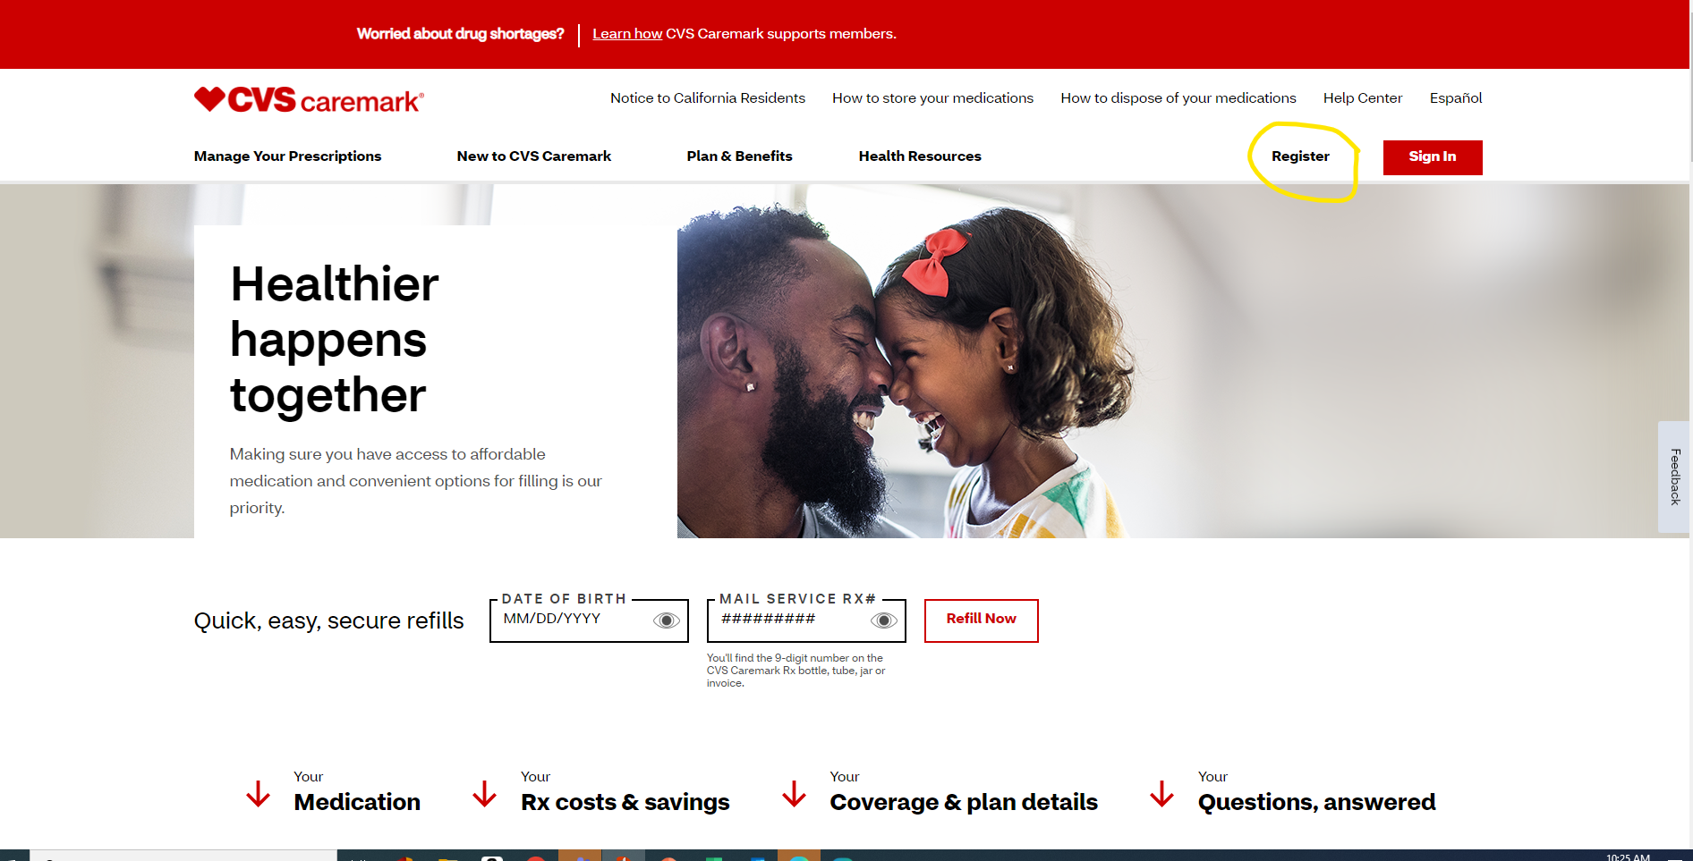
Step 1: Got to Caremark.Com and register for the member portal
Notes:
Step 1: Got to Caremark.Com and register for the member portal

Slide 3
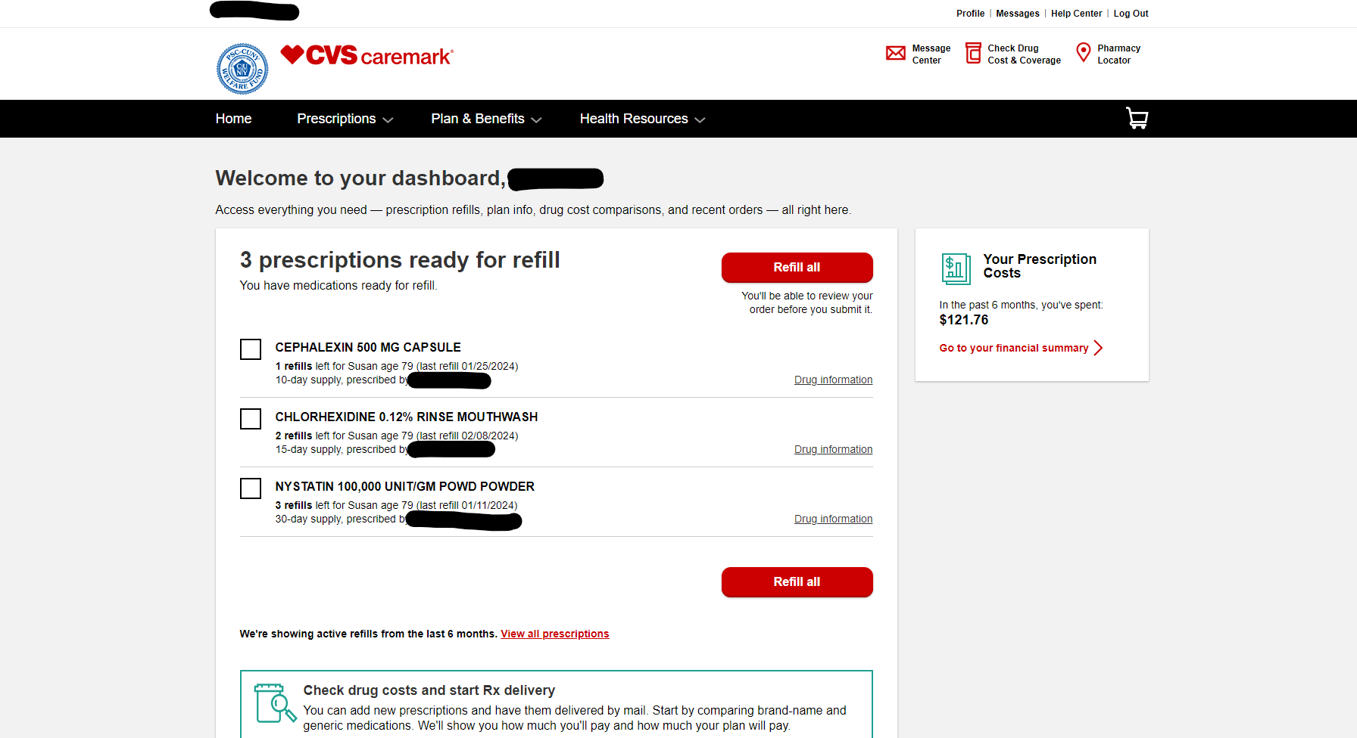
Step 2: Once you sign in, you will be directed to your home page referred to as your “Dashboard”. Here is where you have access to the various tools within CVS Caremark. Most notable are the two icons at the top right Check Drug Cost & Coverage where you can check if a drug is covered and your estimated costs and Pharmacy Locator where you can find a local pharmacy to use to fill your prescriptions as well as determine their hours of operation (if you need a 24 hours location) or even if you can fill 90 days there (expanded Maintenance Choice Pharmacies in select states like FL, OK, etc)

Slide 4
Step 3: Click on Prescriptions and then scroll down to Start Rx Delivery By Mail to get started with filling your prescriptions by CVS Mail Order

Slide 5
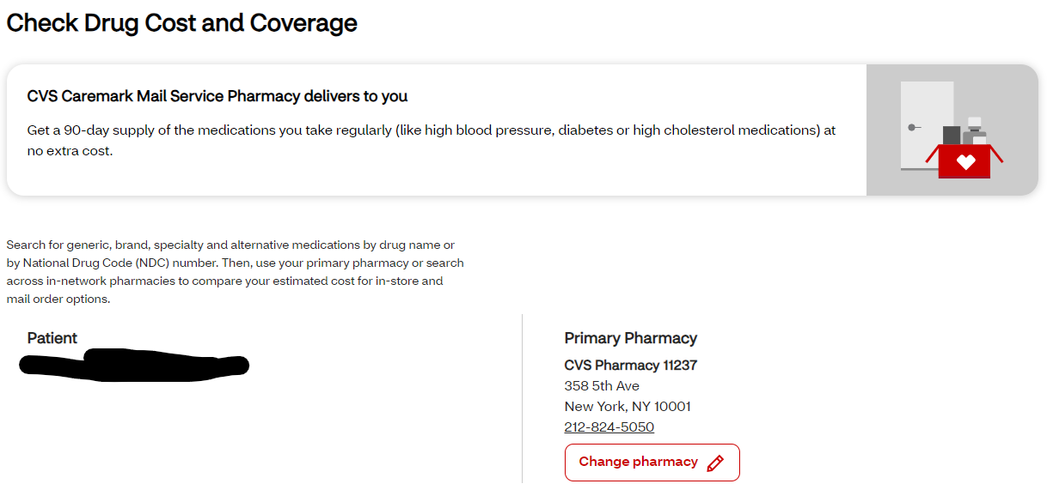
Step 4 – You are now brought to a new screen, and you will need to scroll down to the search tool, or you can utilize one of your current medications listed to start Mail Order with. The initial screen shows to your right the current local pharmacy you are using and to your left who the patient is that we are working on (name/DOB).

Slide 6
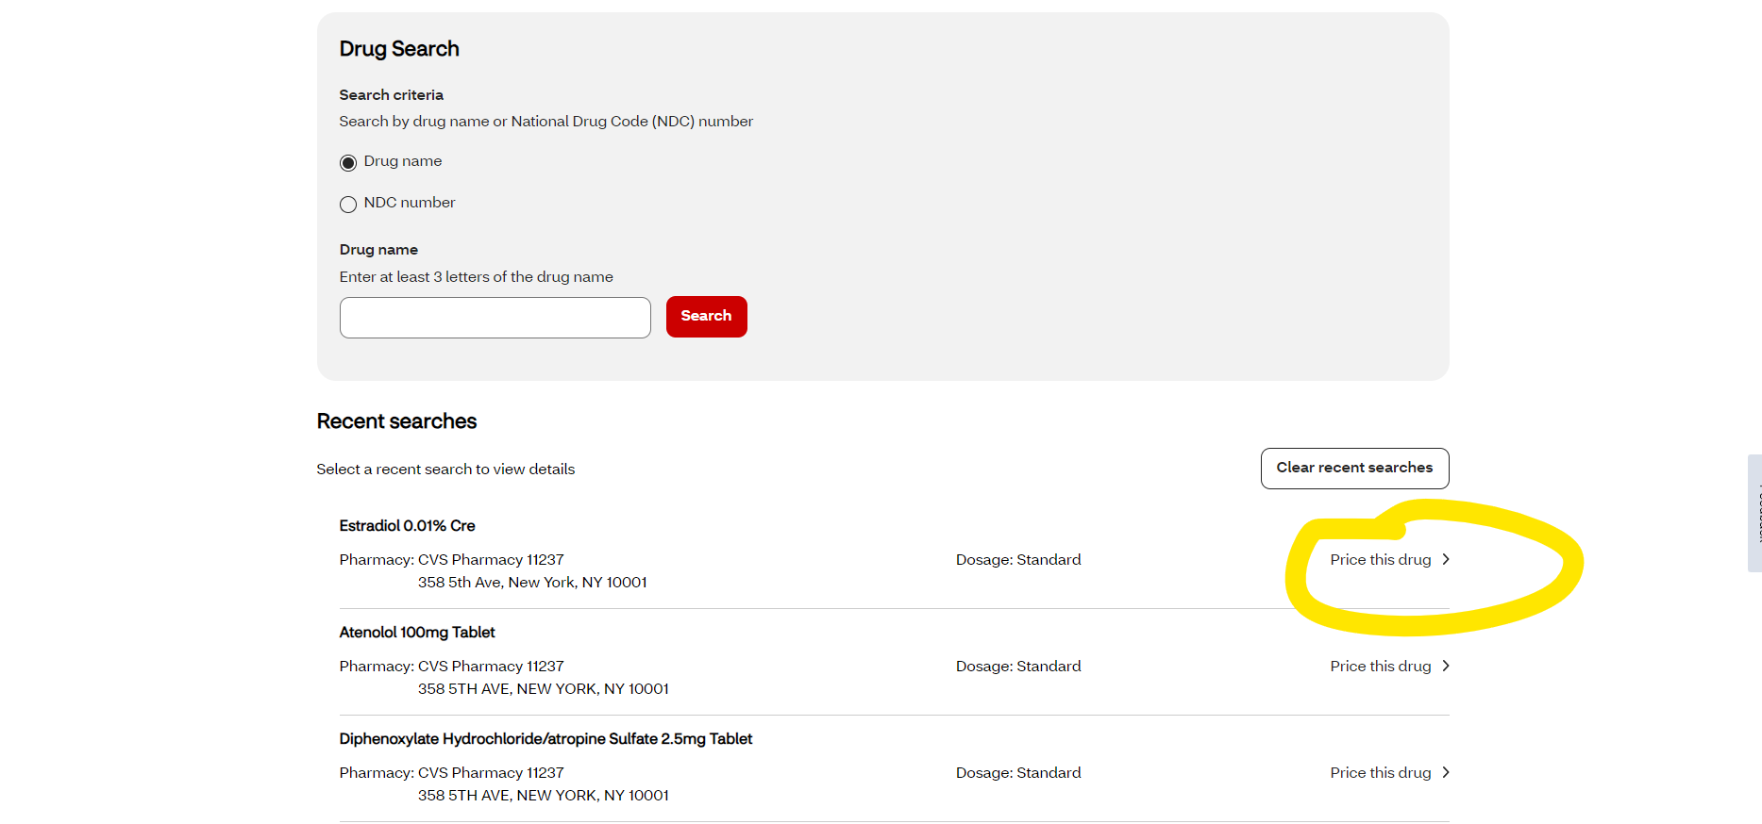
This is the search tool located as you scroll down from the previous slides main screen. You can either type in the medication you need OR pull from the listing of medications below. You will want to click on the Price This Drug link to the right.
Notes:
This is the search tool located as you scroll down from the previous slides main screen. You can either type in the medication you need OR pull from the listing of medications below. You will want to click on the Price This Drug link to the right.

Slide 7
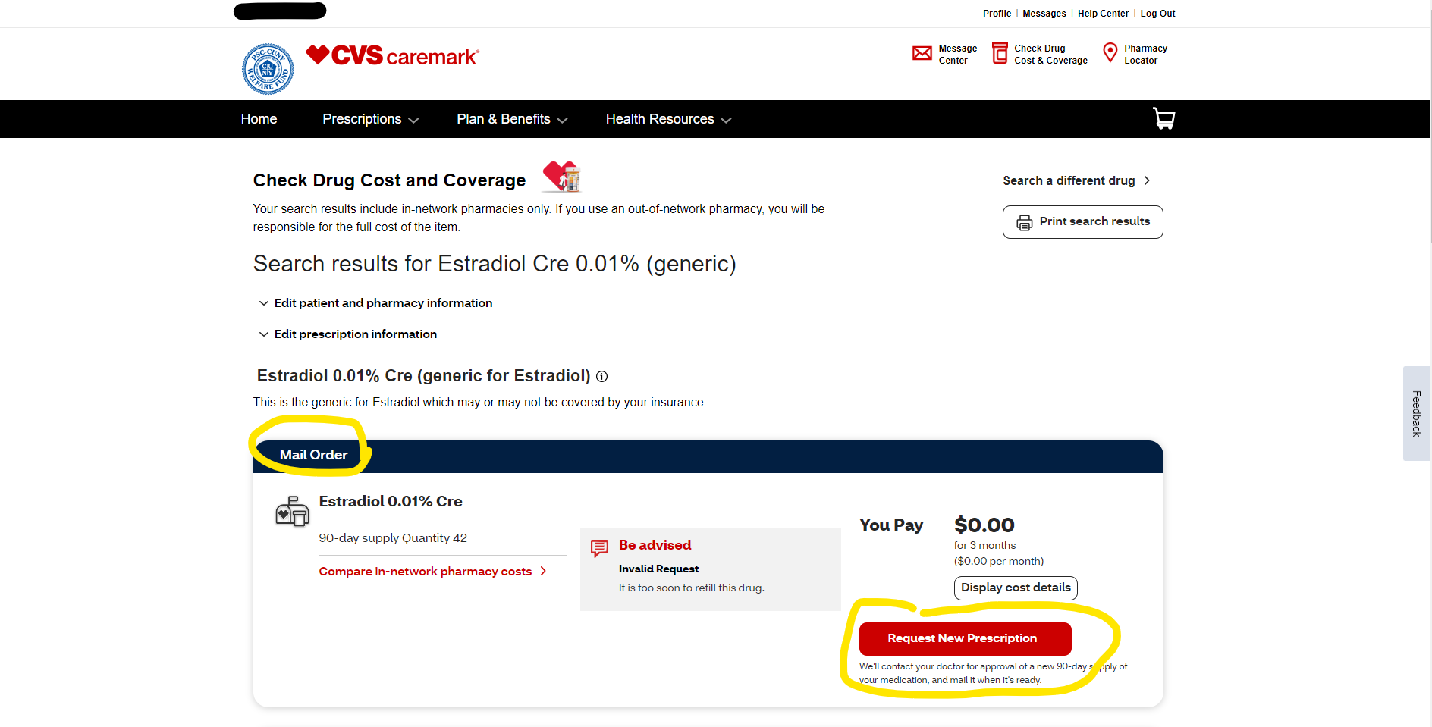
You will then be prompted to a new screen where you can either where you are shown the price at Mail Order (if available), Retail CVS and Retail Non-CVS. From this screen if Mail Order is populated you can request a new 90-day prescription. This request is sent to CVS Mail Order, and they will submit a request to your provider for that medication for 90 days.
If the prescription you choose does not show a Mail Order price, that may be for a few reasons
This medication is not available via mail order
Mail Order is out of stock of this medication
There may be other processing issues or delays
If any of these are the case with your prescription, we ask that you contact Customer Service via the phone number on the back of your prescription ID card.
Notes:
You will then be prompted to a new screen where you can either where you are shown the price at Mail Order (if available), Retail CVS and Retail Non-CVS. From this screen if Mail Order is populated you can request a new 90-day prescription. This request is sent to CVS Mail Order, and they will submit a request to your provider for that medication for 90 days.
If the prescription you choose does not show a Mail Order price, that may be for a few reasons
This medication is not available via mail order
Mail Order is out of stock of this medication
There may be other processing issues or delays
If any of these are the case with your prescription, we ask that you contact Customer Service via the phone number on the back of your prescription ID card.

Slide 8
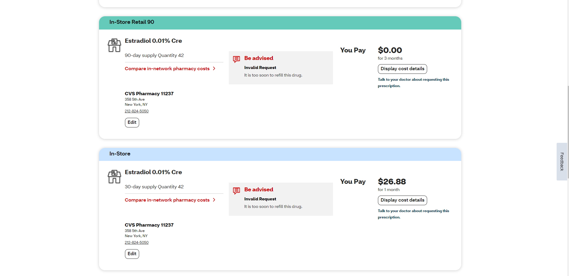
As you can see – member will pay $0 if filled at CVS and around $26.88 if filled outside of CVS. This cost can also be given for those members who did not transition to a 90 days for maintenance drugs as well.
Notes:
As you can see – member will pay $0 if filled at CVS and around $26.88 if filled outside of CVS. This cost can also be given for those members who did not transition to a 90 days for maintenance drugs as well.

Slide 9
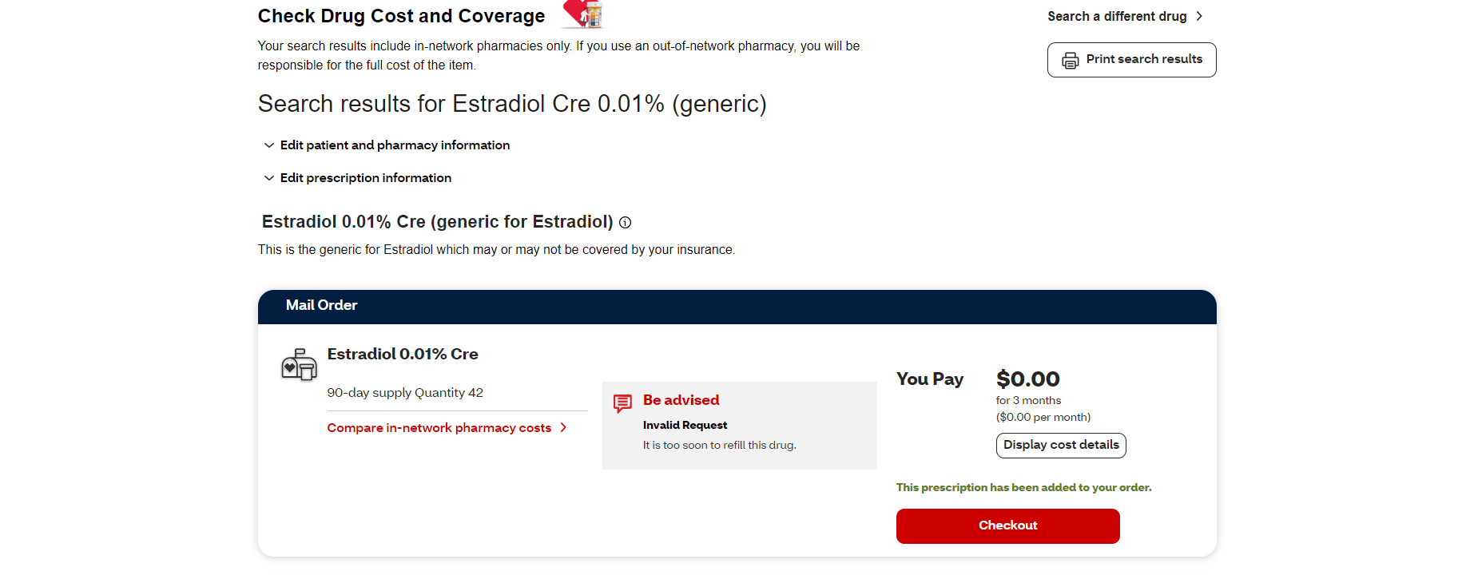
Once you click on Request New Prescription it will show the following screen and prompt you to check out to review your selections.
Notes:
Once you click on Request New Prescription it will show the following screen and prompt you to check out to review your selections.

Slide 10
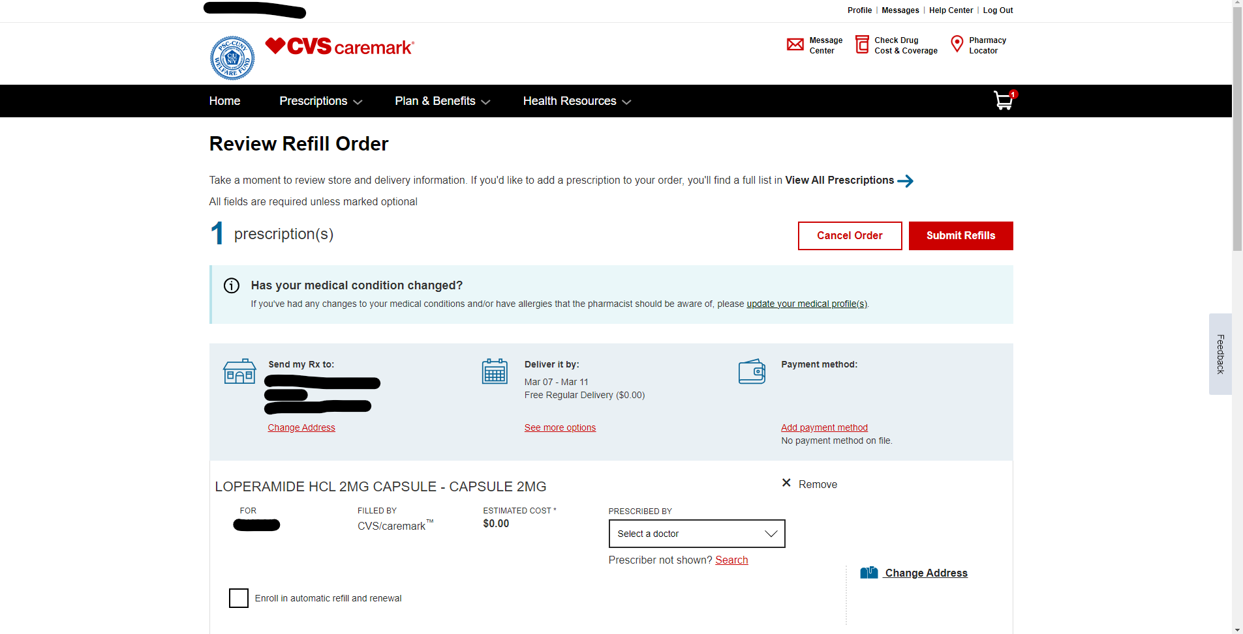
Now you have reached the Check Out screen where you need to verify all information before submitting to Mail Order. You can see the address we have on file for which the medication will be shipped to (Send my Rx to) and you can modify if you wish to utilize another address for shipping
You will see around the time the medication can be shipped and change if you would like a different date range (Deliver it by)
You can also see where you can add a payment method to your mail order claim (Payment Method) and this will be used to process any payments (if needed)
Notes:
Now you have reached the Check Out screen where you need to verify all information before submitting to Mail Order. You can see the address we have on file for which the medication will be shipped to (Send my Rx to) and you can modify if you wish to utilize another address for shipping
You will see around the time the medication can be shipped and change if you would like a different date range (Deliver it by)
You can also see where you can add a payment method to your mail order claim (Payment Method) and this will be used to process any payments (if needed)

Slide 11
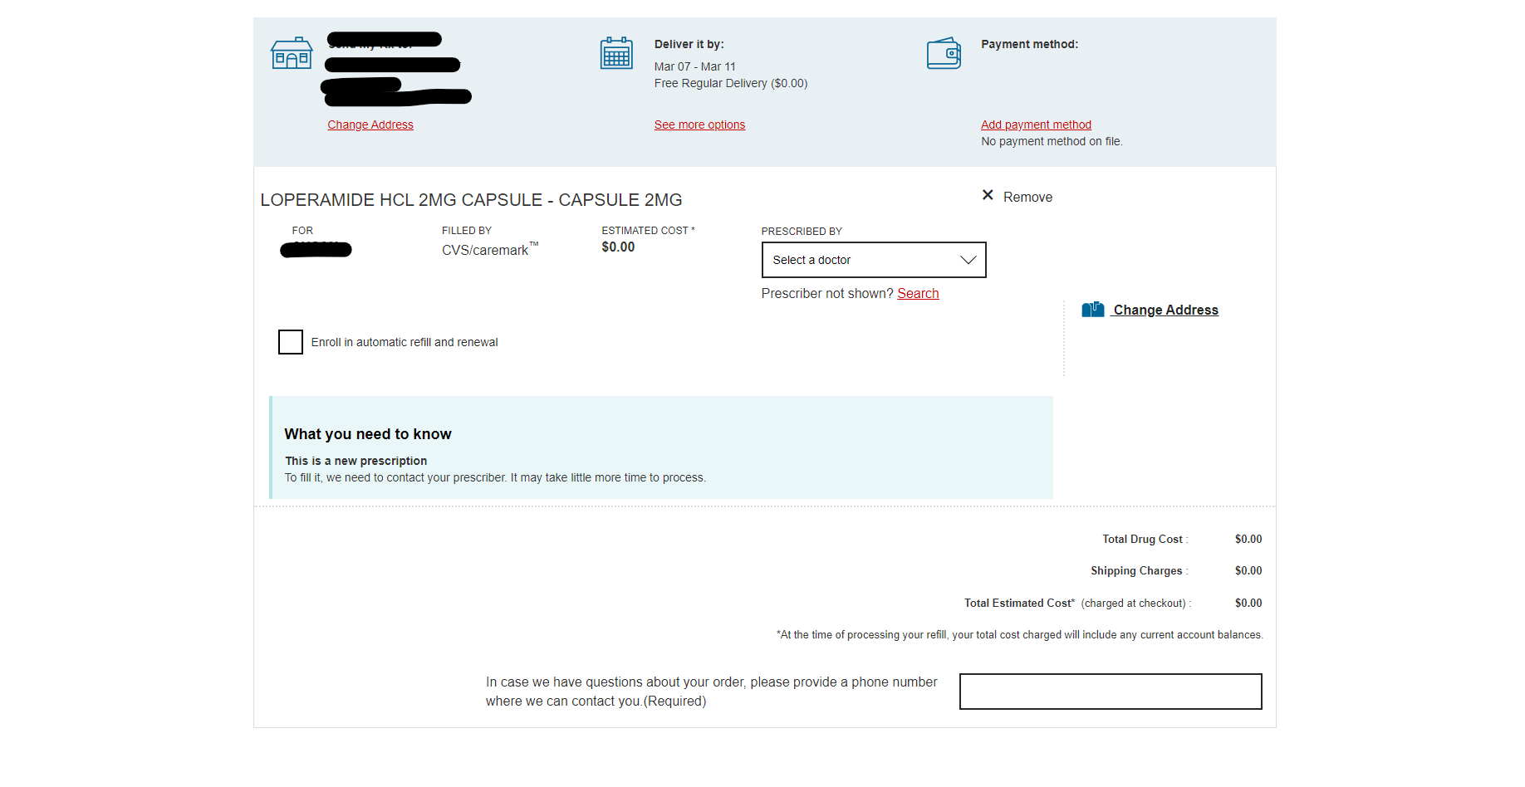
You need to add the doctor for which you want Mail Order to reach out to for the 90-day prescription (Prescribed By)
You can also set up automatic refills and automatic renews here as well by checking that box to your left (Enroll in automatic refill and renewal) – so if the provider writes a script with refills, when the refills are due, mail order will automatically fill them (automatic refill) and when you run out, we will automatically contact your physician for a new prescription (renewal)
Notes:
You need to add the doctor for which you want Mail Order to reach out to for the 90-day prescription (Prescribed By)
You can also set up automatic refills and automatic renews here as well by checking that box to your left (Enroll in automatic refill and renewal) – so if the provider writes a script with refills, when the refills are due, mail order will automatically fill them (automatic refill) and when you run out, we will automatically contact your physician for a new prescription (renewal)

Slide 12
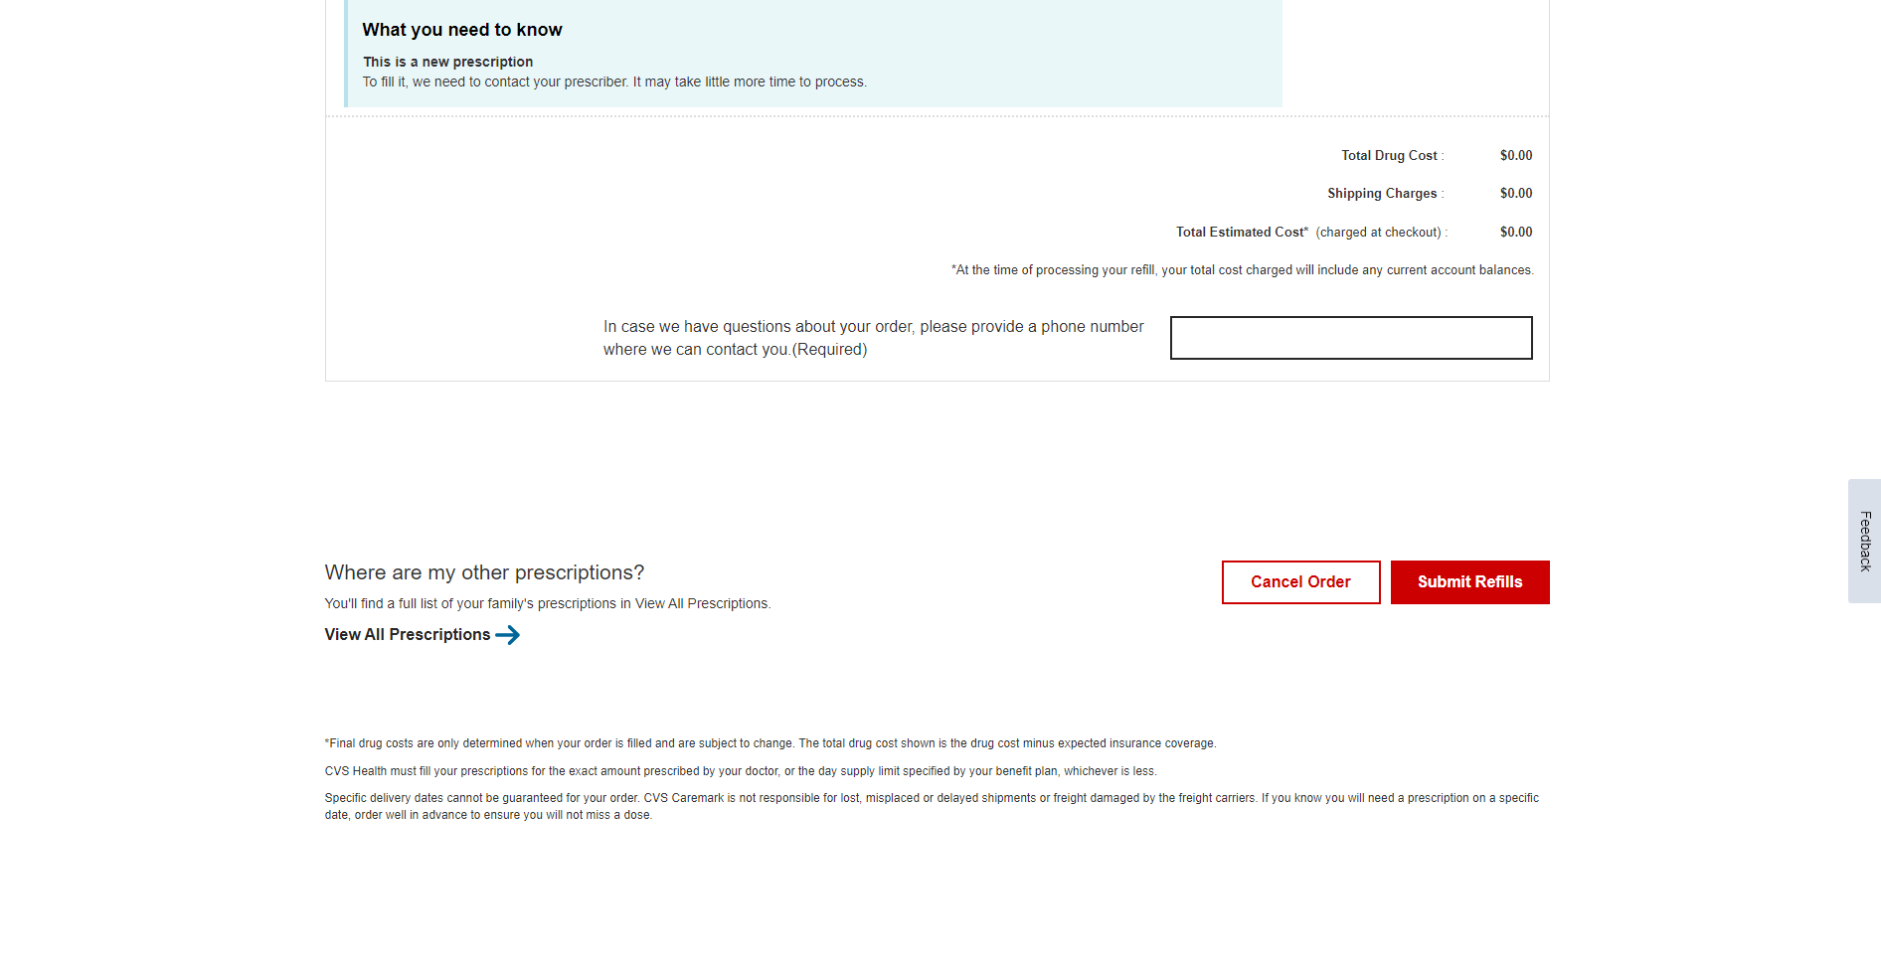
You will see the charge for transitioning to Mail Order and then need to confirm this order before it will be completed. You confirm your selections by clicking Submit Refills.
You can view all prescriptions and pull as many as you would like for Mail Order to add to before clicking Submit Refills OR if you decide you do not want to do Mail Order at this time, you can Cancel your Order all together.
Notes:
You will see the charge for transitioning to Mail Order and then need to confirm this order before it will be completed. You confirm your selections by clicking Submit Refills.
You can view all prescriptions and pull as many as you would like for Mail Order to add to before clicking Submit Refills OR if you decide you do not want to do Mail Order at this time, you can Cancel your Order all together.

